Slide 1
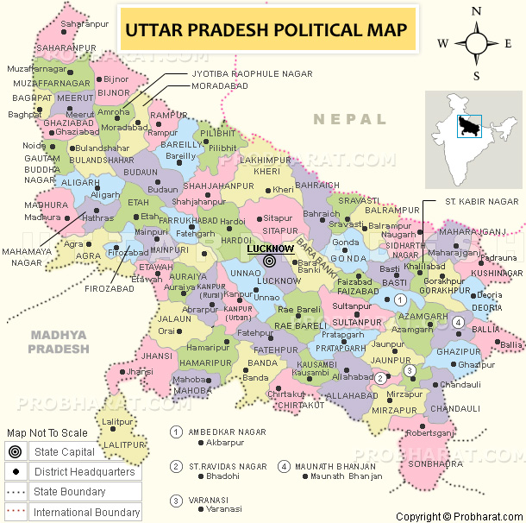
Newsletter- April 2018
Jaunpur historically known as Sheeraz-e-Hind having its historical dates from 1359, when the city was founded by the Sultan of Delhi feroz shah Tughlag and named in memory of his cousin, Muhammad bin Tughlag whose given name was Jauna Khan. Jaunpur is well-connected with all major cities of India thanks to Indian Railways . It has four major railway stations: Jaunpur City Railway Station (JOP) and Jaunpur Junction (JNU),
The Nagar Palika Parishad has population of 181,009 of which 94,318 are males while 86,682 are females and 9 other as per the Census India 2011.
Population of Children with age of 0-6 is 20,918 which accounts 11.55 % of total population of NPP. The Female Sex Ratio is 901 against state average of 912. Moreover, Child Sex Ratio in town is around 893 compared to Uttar Pradesh state average of 902. Literacy rate of town is 74.084% higher than state average of 67.68 %.
Total workforce participation is 26%.
Jaunpur

Slide 2
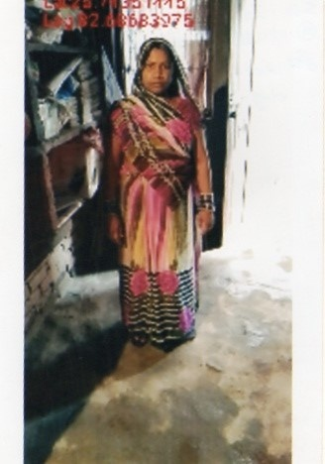
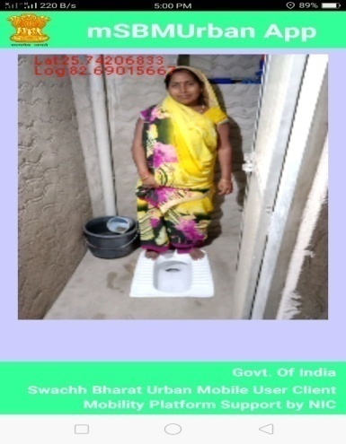
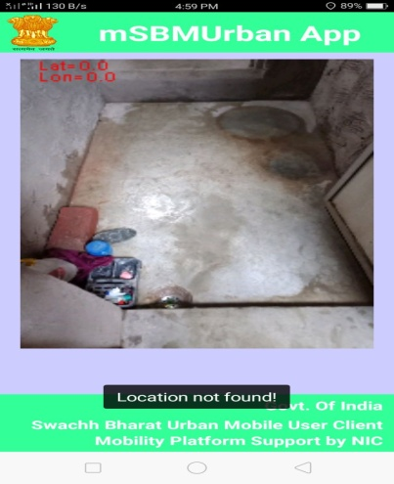
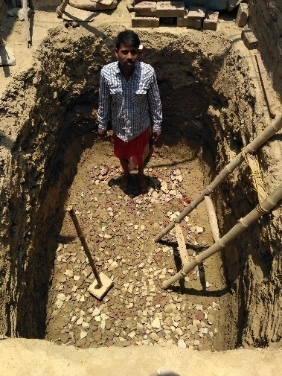
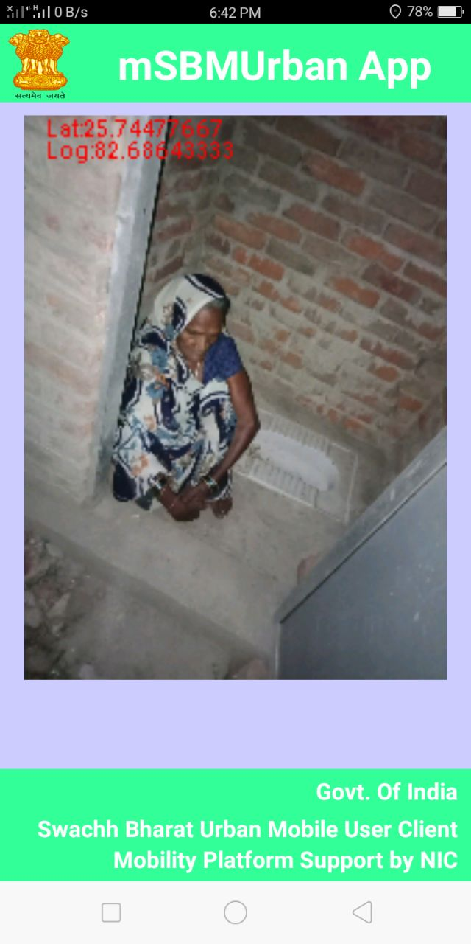
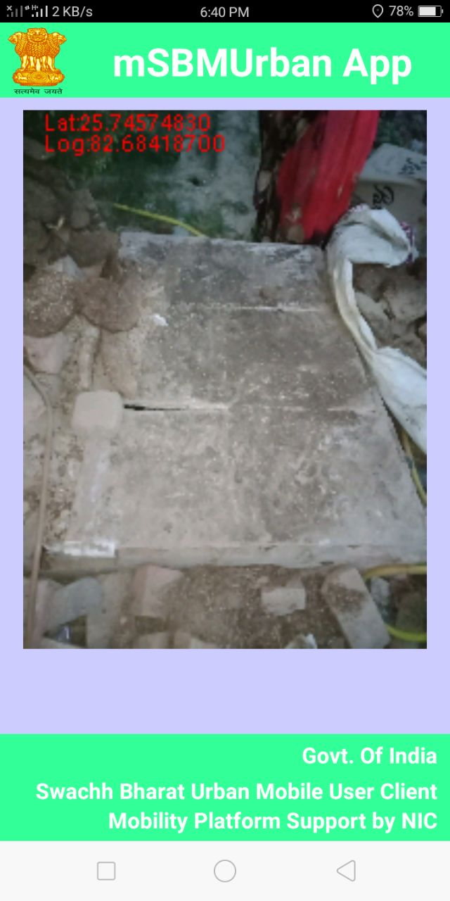
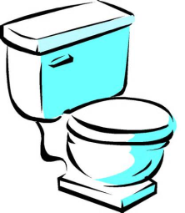
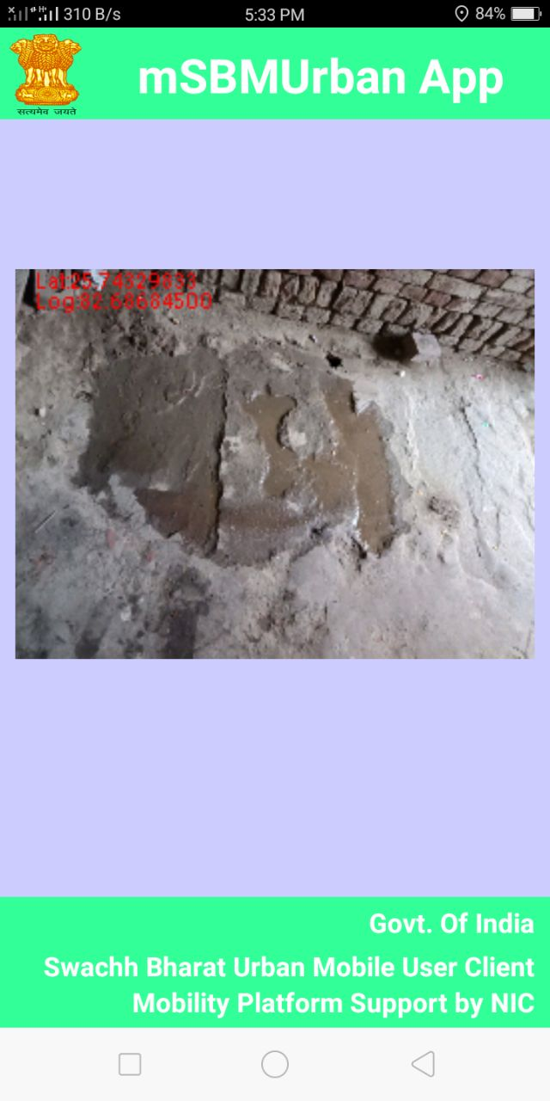
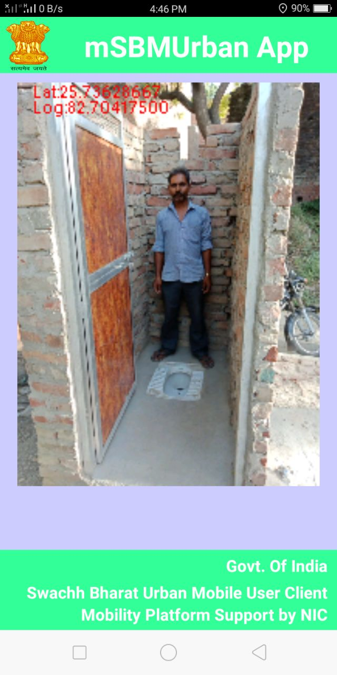
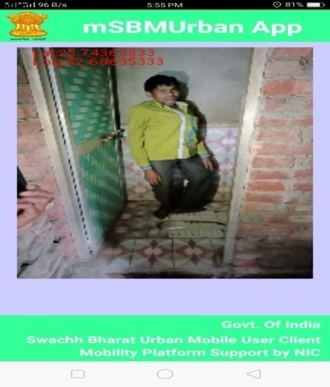
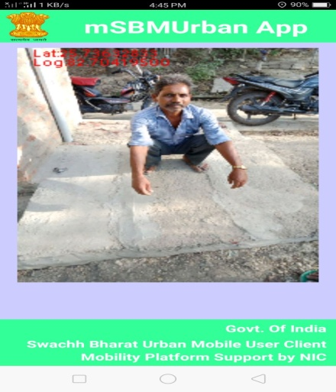
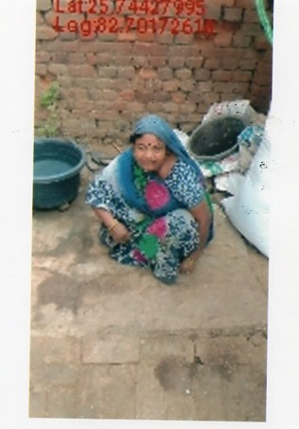
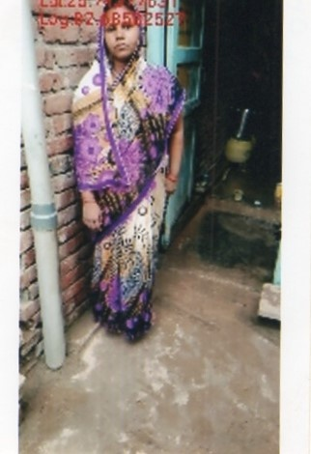
SBM Status
Status of application for the IHHT
Received – 6332
Verified – 1818
Approved – 1813
Rejected -3006
Commenced toilet Photo – 899
Constructed toilet photo – 983

Slide 3
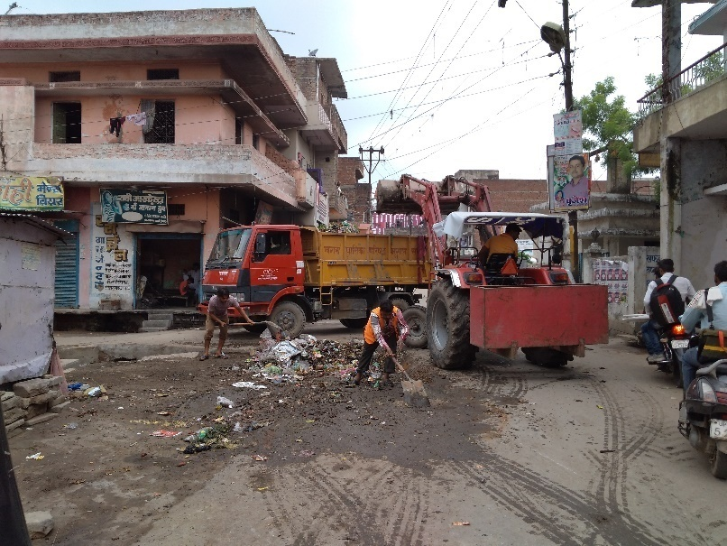
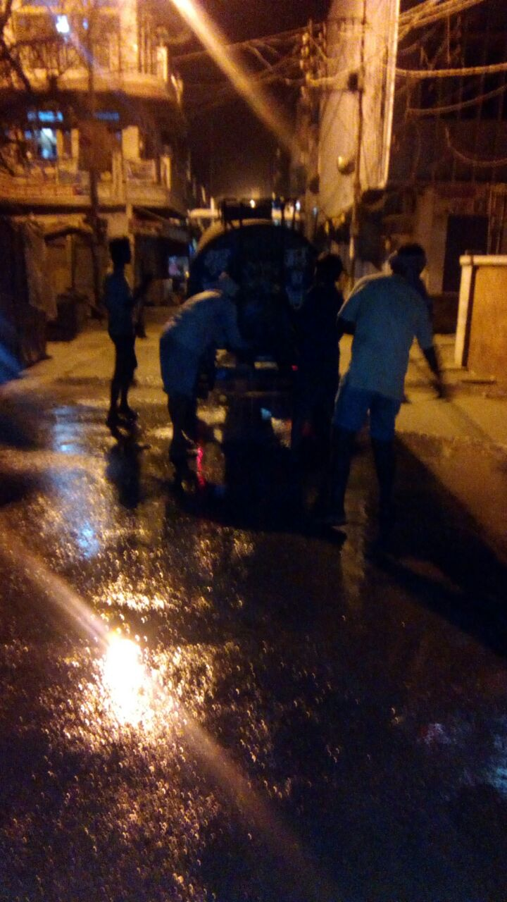
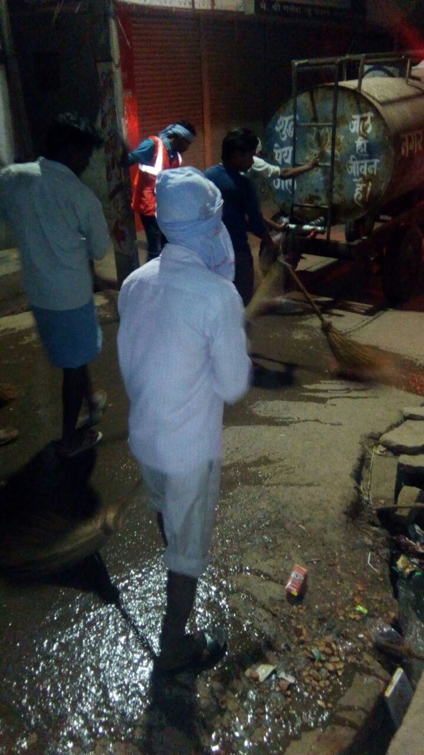
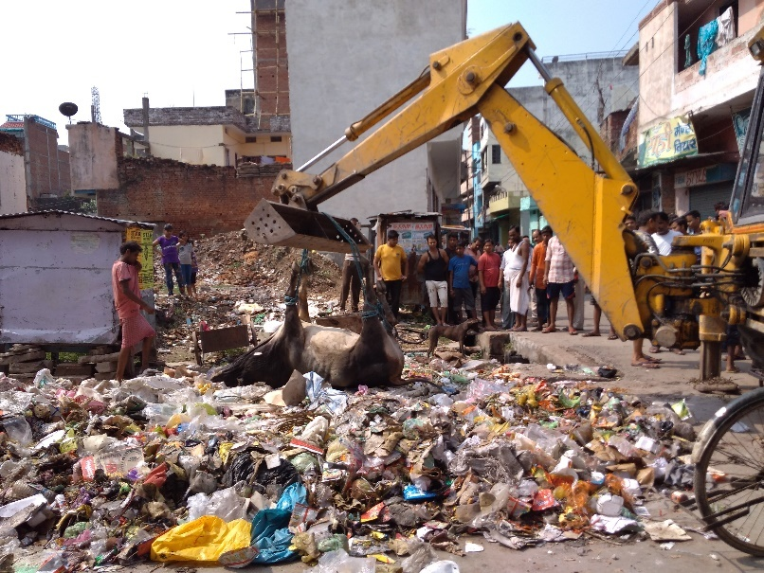
Waste Management - Area of NPP- 43.41 SQKM ( UNDER CONSTRUCTION ) - Generated waste- 82 tons/day - Frequency of waste collection- Daily - Frequency of waste transportation- Daily - Door to door collection- 19 - Source segregation- 04 Wards - Vehicles for waste collection - Tractor- 4 - Dumper Placer – 5 - Compactor – 1 - JCB Loader – 2 - Dumping sites –1 - Scientific management - No
Waste transportation
Drain cleaning
Drain cleaning on daily basis
Removing dead Body from Waste Dumping point

Slide 4
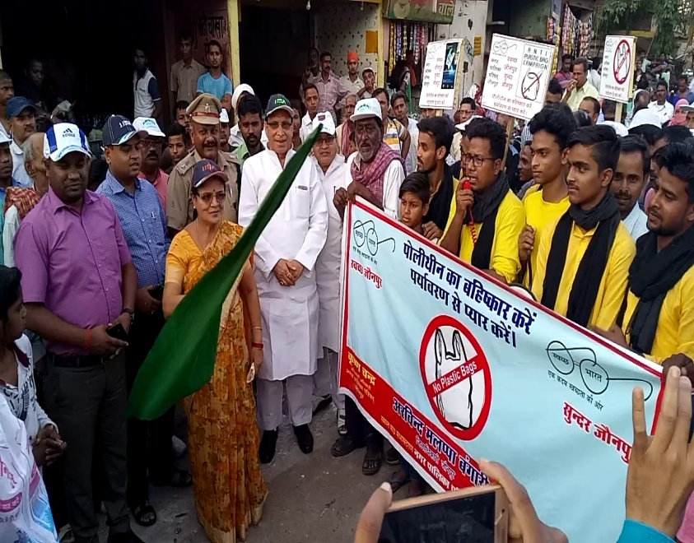
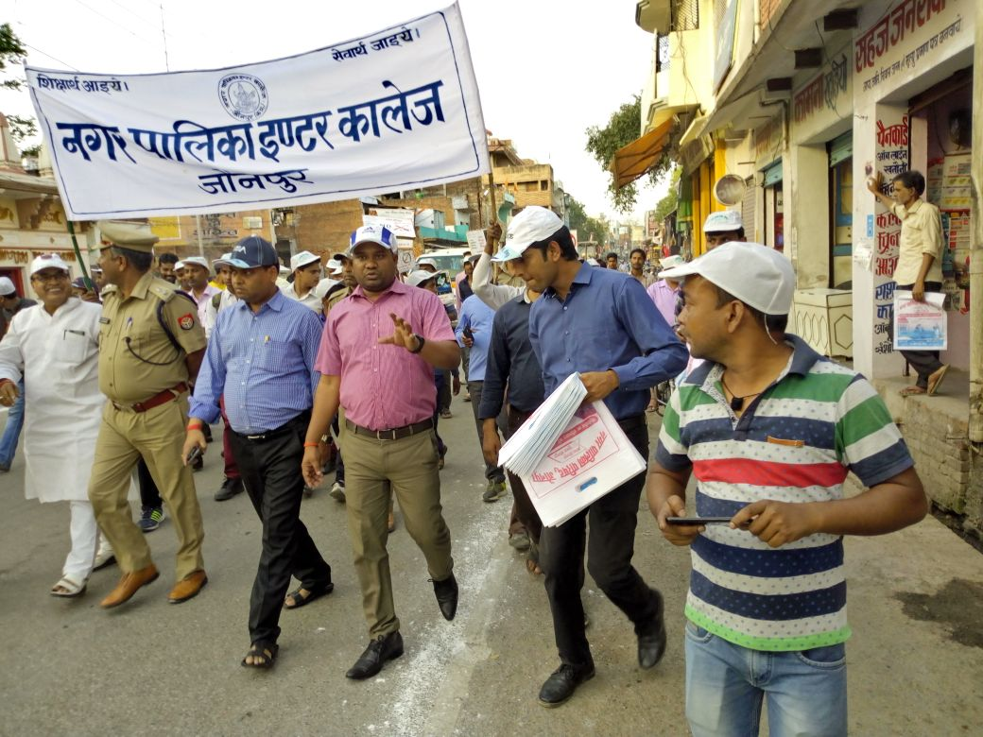
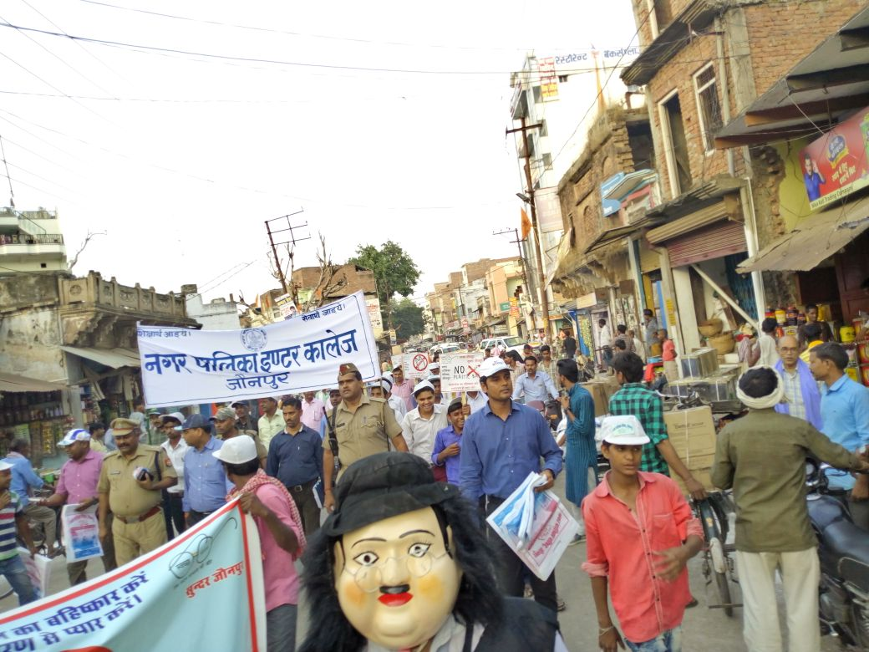
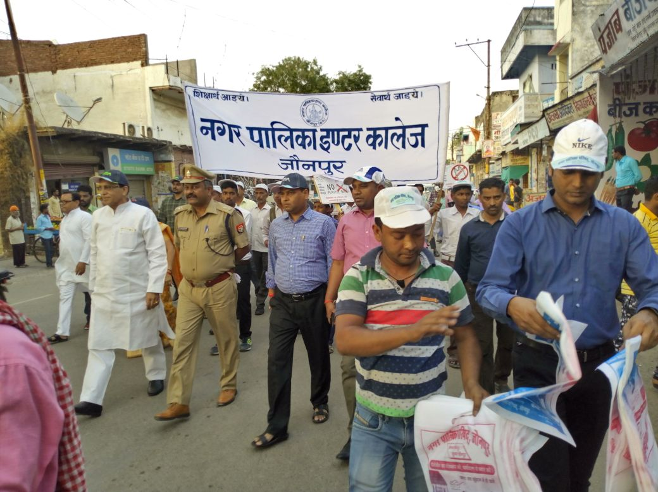
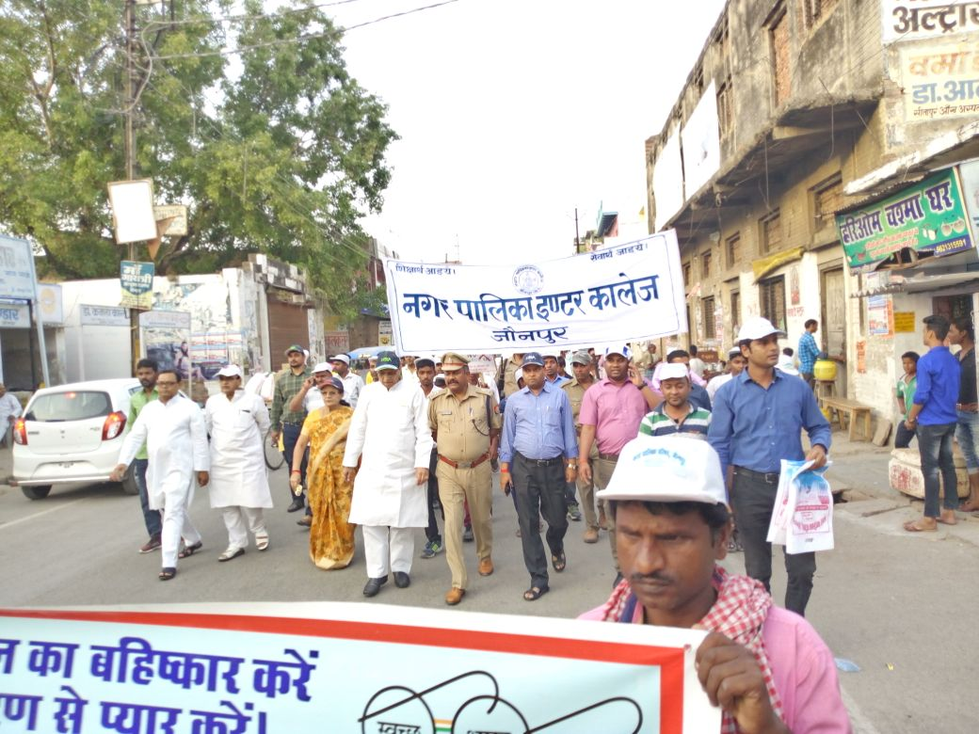
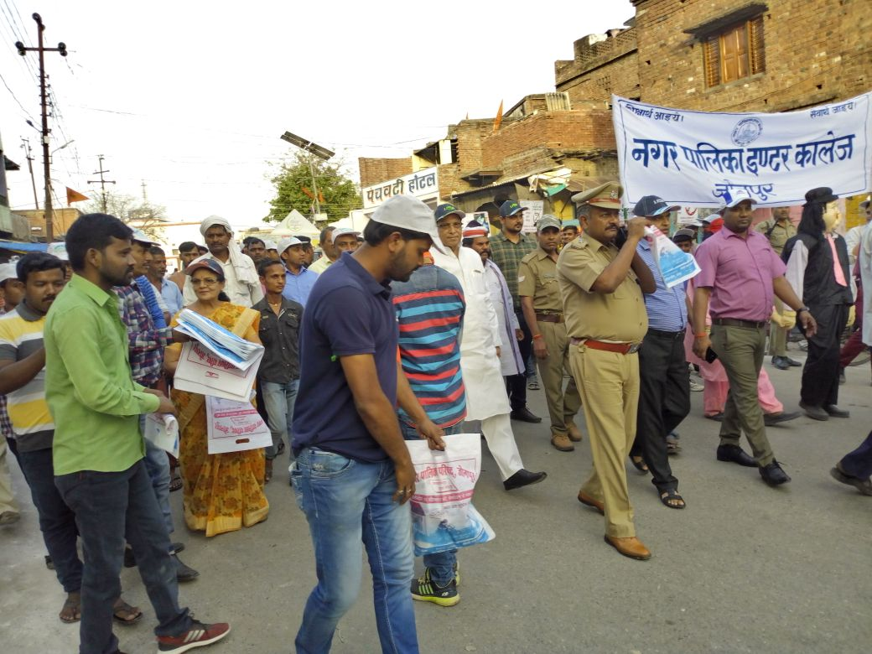
Anti Polythene campaign under SBM

Slide 5
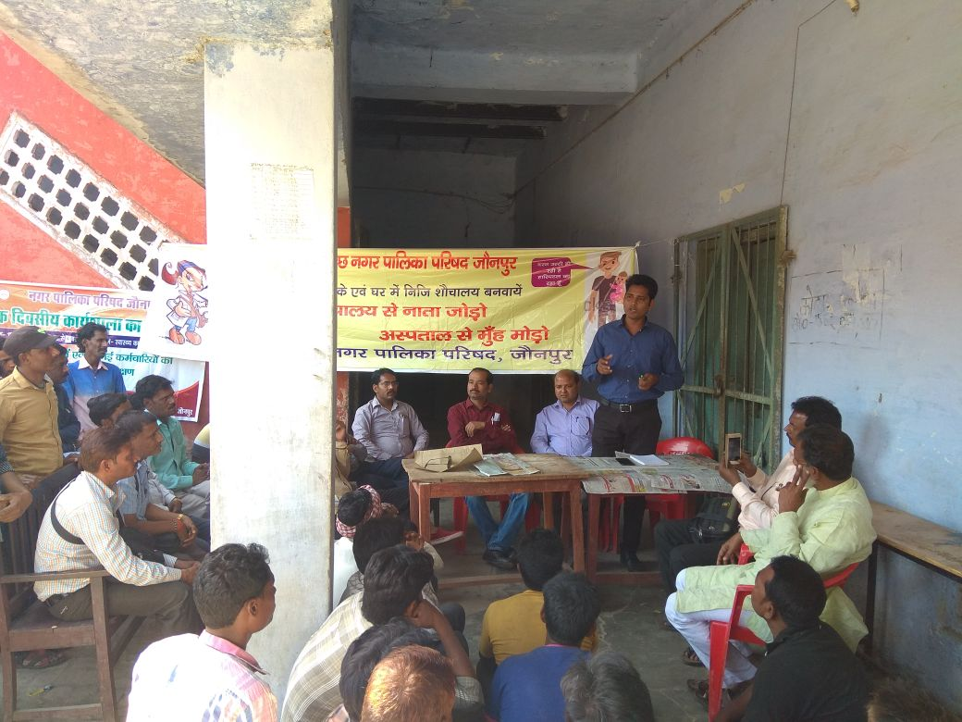
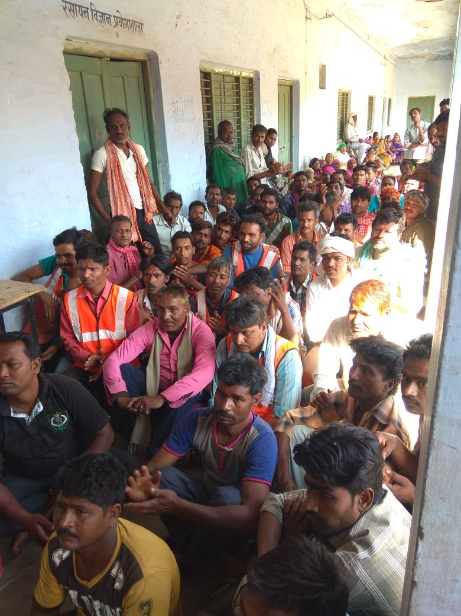
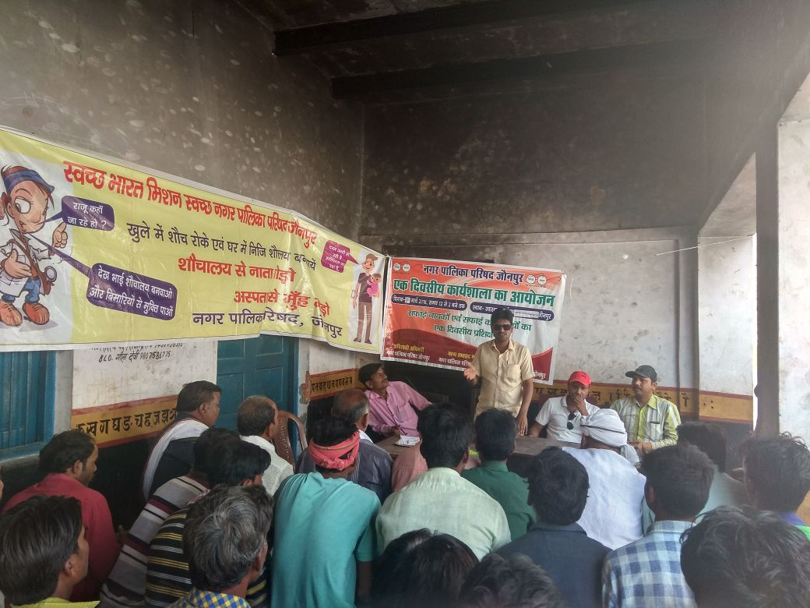
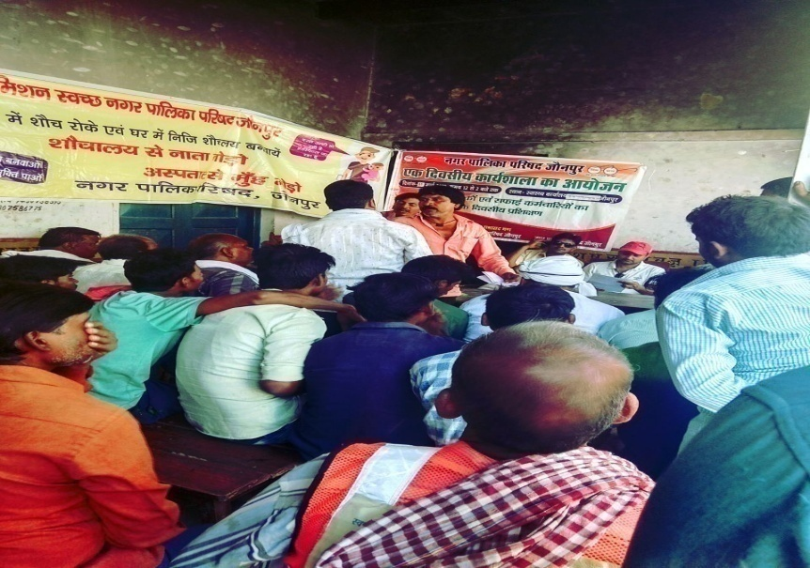
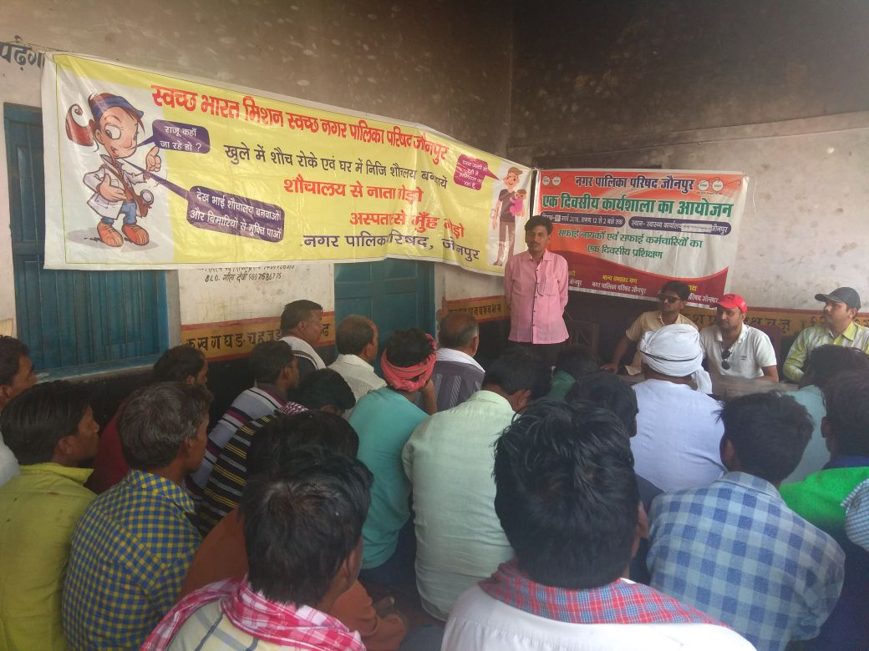
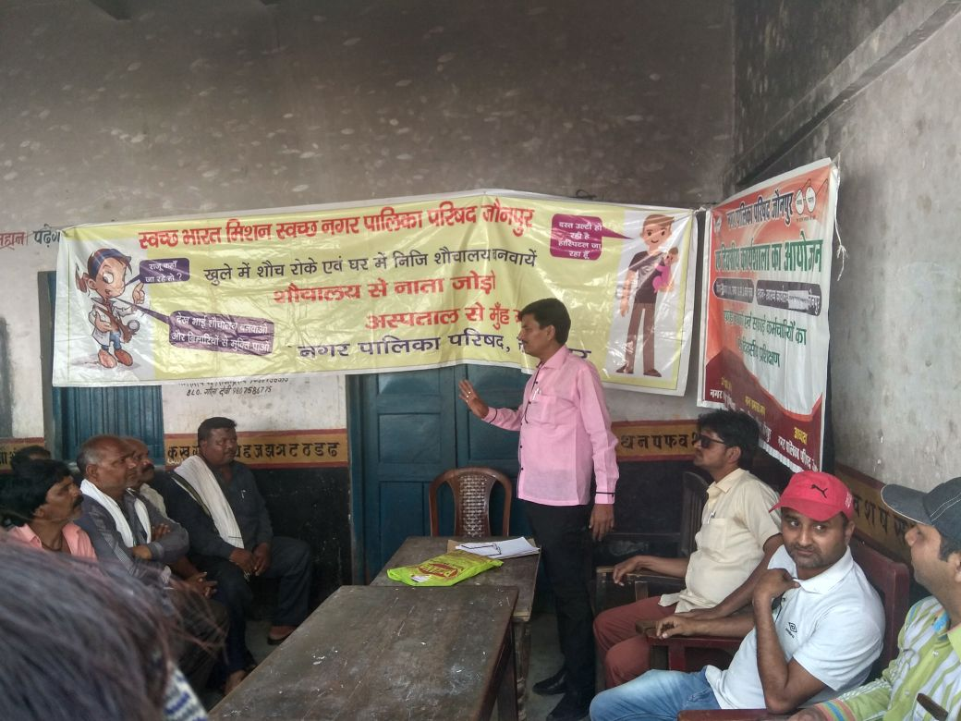
Workshop for capacity building of sweepers under SBM

Slide 6
AMRUT Scheme
Ongoing Project
Water Supply
1) Jaunpur NPP Water Supply house connection under AMRUT (for 31 wards) – Project Approved of total project cost INR 817.70/727.64 Lacs.
~3250 Houses are connected with old water supply connection
Sewerage and Septage Management
DPR for Sewerage is prepared by Jal nigam jaunpur.
Land identification for construction of STP is under process
Parks & Garden
Parks – 03 PARK DPR Approved BY SLTC RCUES LUCKNOW and 02 PARK TENDER( TECHNICAL BID) OPENED SO park development is under process
parks and gardens exist in the city

Slide 7
AMRUT Reforms
Credit Rating
Ongoing EMAAS
e-newsletter
Registration of Birth & Death
Water & Sewerage Charges
Grievance Redressal
Property Tax
Issuance of Licenses
Double Entry Accounting
E- procurement
“IND-BB”
AMRUT Reforms
NRW - 22.87%
Non-revenue Water
Municipal Tax and Fees Improvement
www.nppjaunpuronline.org
Yet to be done
Building Permissions,
Mutations,
Payroll,
Pension
User Charges
Only 100% Billing is being done
Only 80.16% Collection is being done

Slide 8
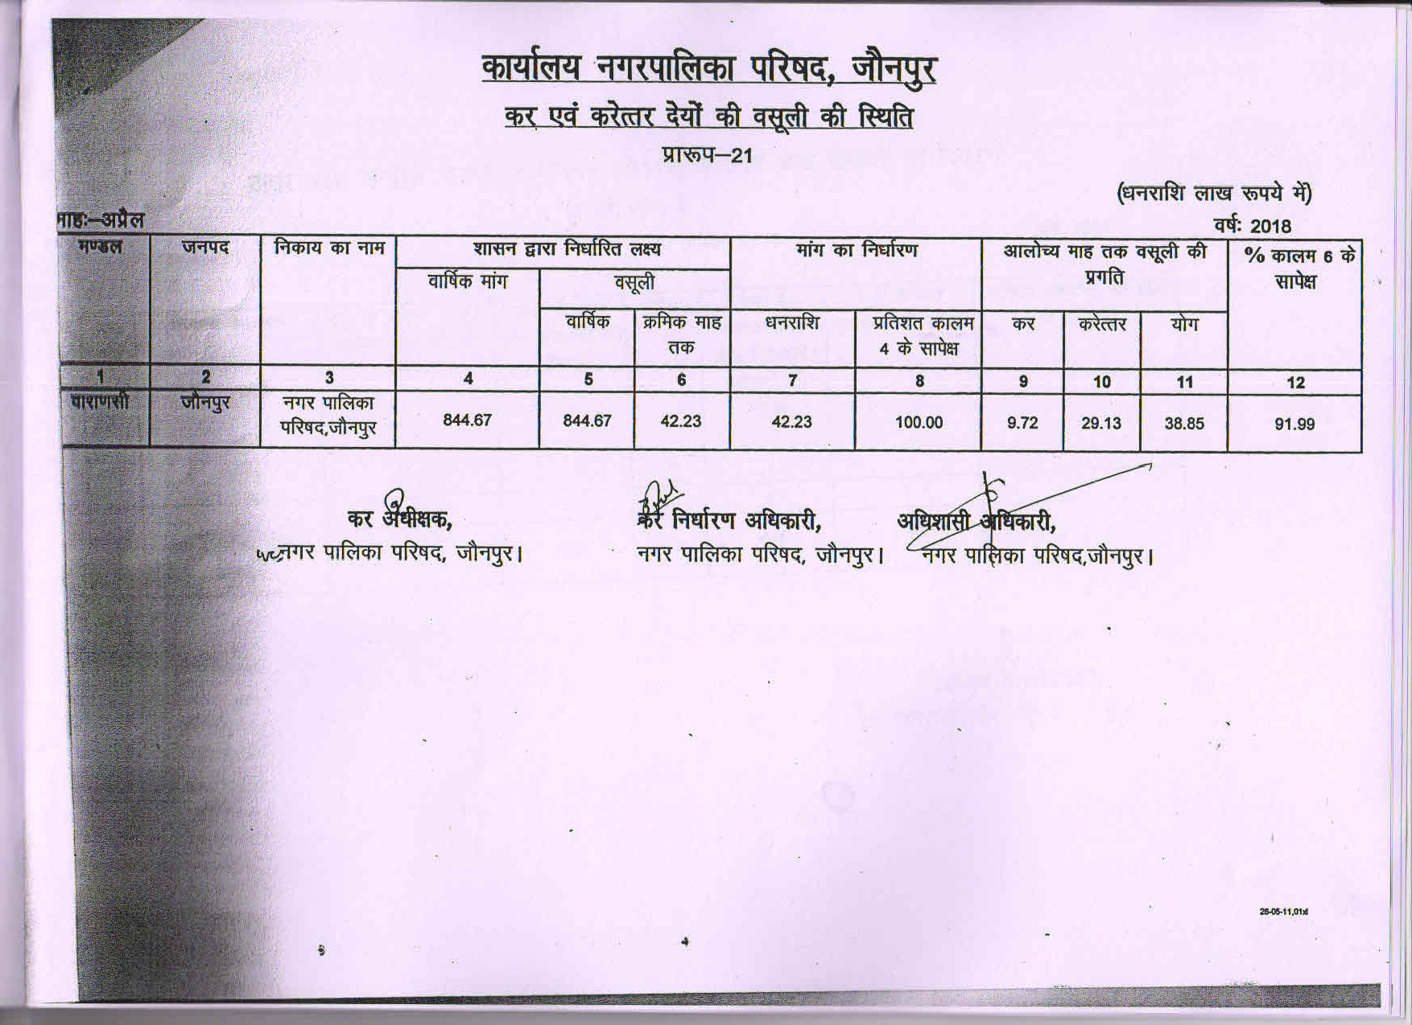
Details of Tax collected during April 2018

Slide 9
Meetings and Workshops
Capsule-3 Training” Under AMRUT Scheme for Shri Amresh saran yadav & Shri hatim hashan in RCUES from 09-04-2018 to 11-04-2018. on topic the orientation training programme
Capsule-3 Training” Under AMRUT Scheme for Shri Tarkeshwar singh in RCUES from 03-04-2018 to 05-04-2018. on topic office management computer & soft skills
“Capsule-3 Training” Under AMRUT Scheme for Shri Amresh saran yadav in RCUES from 23-04-2018 to 25-04-2018. on the topic orientation training programme

